Slide 1
IPv4 Addressing

Slide 2
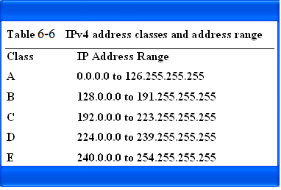
The IPv4 classes and address range

Slide 3
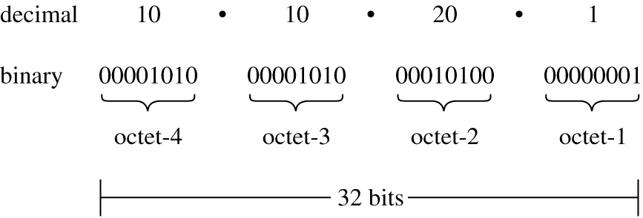
The structure of the 32-bit IPv4 address

Slide 4
Decimal 10 10 20 1
Binary 00001010 00001010 00010100 00000001
Fig. 6-12 The structure of the 32-bit IP address.

Slide 5
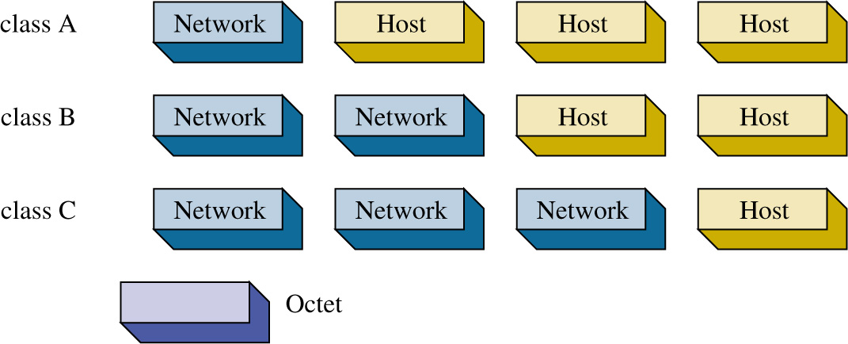
The octets making up the network and host portions of the IPv4 address for classes A, B, and C.

Slide 6
Table 6-8 The breakdown of the network and host bits by class.
Class Network Bits Host Bits
A 8 24
B 16 16
C 24 8

Slide 7
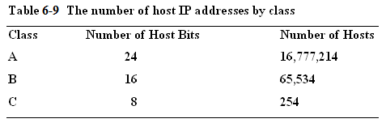

Slide 8
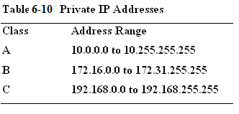
Address ranges in class A,B, and C have been set aside for private use. These addresses, called private addresses, are not used for Internet data traffic but are intended to be used specifically on internal networks called Intranets.

Slide 9
Functionally, private addresses work the same as public addresses except private addresses are not routed on the Internet. These are called non-routable IP address and are block by the Internet Service Providers.

Slide 10
ARIN
IP addresses are assigned by ARIN, the American Registry for Internet Numbers. www.arin.net
ARIN assigns IP address space to Internet Service Provides (ISP) and end users. ARIN only assigns IP address space to ISPs and end users if they qualify.
This requires that the ISP or end user be large enough to merit a block of addresses. In the case where blocks of addresses are allocated by ARIN to the ISPs, the ISPs issue addresses to their customers.
For example, a Telco could be the ISP that has a large block of IP addresses and issues an IP address to a user. A local ISP could also be assigned a block of IP addresses from ARIN, but the local ISP must have a large number of users.

Slide 11
ARIN
ARIN also assigns end users IP addresses. Once again, the end user must qualify to receive a block of addresses from ARIN. This usually means that the end user must be large.
For example, many universities and large businesses can receive a block of IP addresses from ARIN. However, most end users will get their IP addresses from an ISP (e.g. Telco) or have IP addresses assigned dynamically when they connect to the ISP.

Slide 12
Subnetting
Subnetting is a technique used to break down (or partition) networks into subnets. The subnets are created through the use of subnet masks.
The subnet mask identifies what bits in the IP address are to be used to represent the network/subnet portion of an IP address.

Slide 13


Slide 14
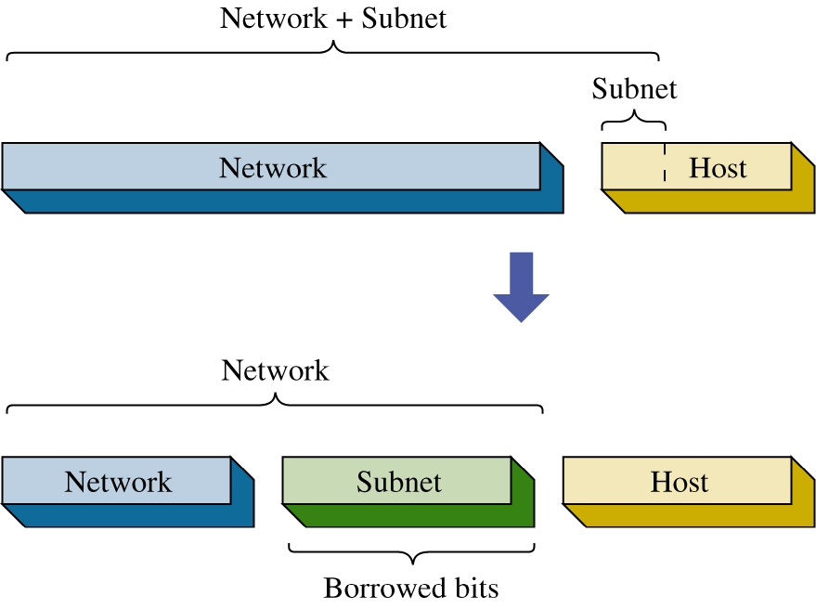
The subnets are created by borrowing bits from the host portion of the IP address as shown.
The network portion of the IP address and the new subnet bits are used to define the new subnet. Routers use this information to properly forward data packets to the proper subnet.

Slide 15
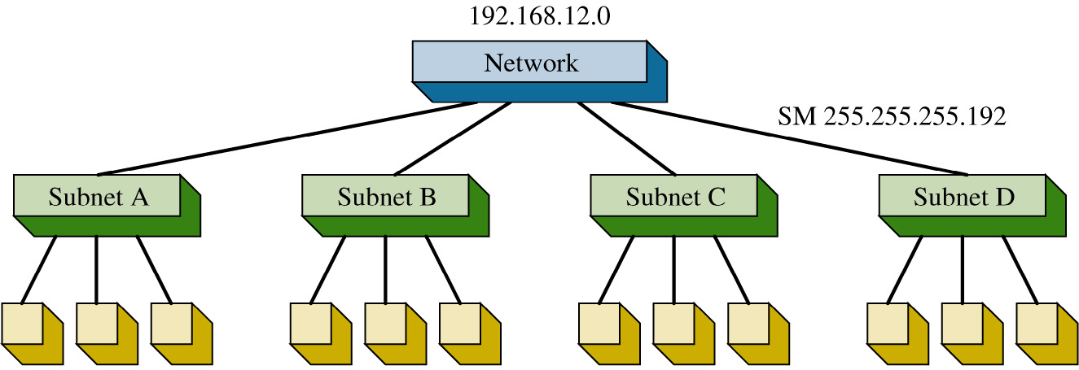
The Class C network, shown is partitioned into four subnets. It takes 2 bits to provide four possible subnets therefore 2-bits are borrowed from the host bits.
This means the process of creating the four subnets reduces the number of bits available for host IP addresses.

Slide 16
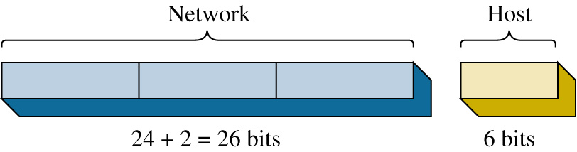

Slide 17
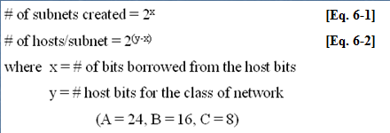
The equations for calculating the number of subnets created and the number of hosts/subnet.

Slide 18
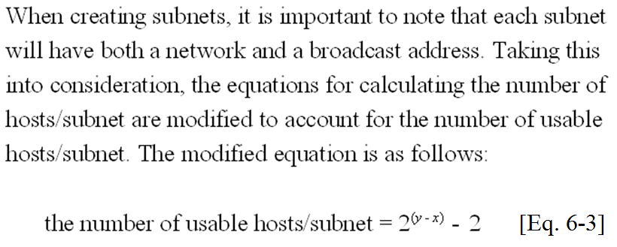

Slide 19
192.168.12.0
Network
Subnet A Subnet B Subnet C Subnet D
subnet mask = ?
Partitioning a network into subnets.

Slide 20
Network Host
24 + 2 = 26 bits 6 bits
The next step is to determine the subnet mask required for creating the four subnets. Recall that creating the four subnets required borrowing 2 host bits.
The two MSB (most significant bit) positions, borrowed from the host and network portion of the IP address must be included in the subnet mask selection.
The purpose of the subnet mask is to specify the bit positions used to identify the network and subnet bits.

Slide 21
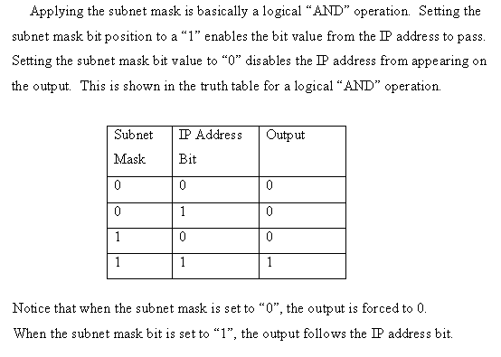

Slide 22
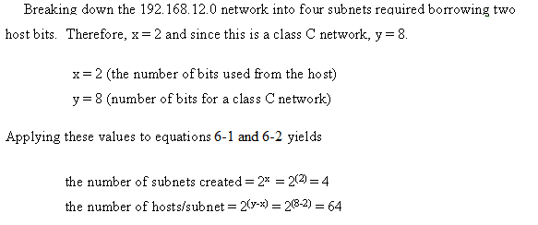
Applying equations 6-1 and 6-2 to calculate the number of subnets and hosts/subnet.

Slide 23
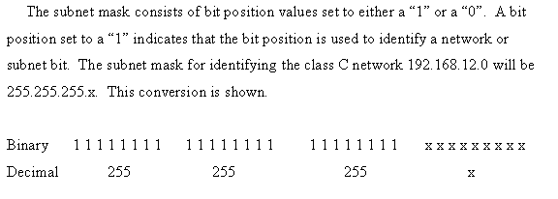
192 168 12 - - - -
Creating the subnet mask to select the 192.168.12.0 subnet.

Slide 24
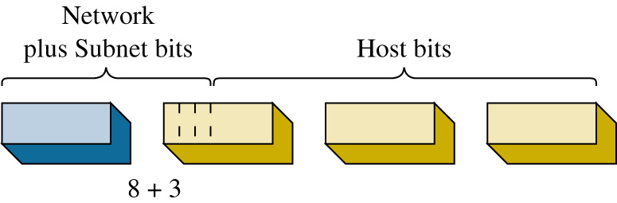

Slide 25
Network + Subnet
subnet
Network Host
Network Subnet bits Host bits
Network
Borrowed bits
Borrowing bits from the host to create subnets.

Slide 26
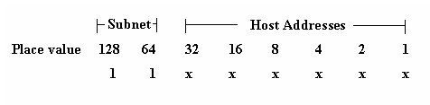

Slide 27
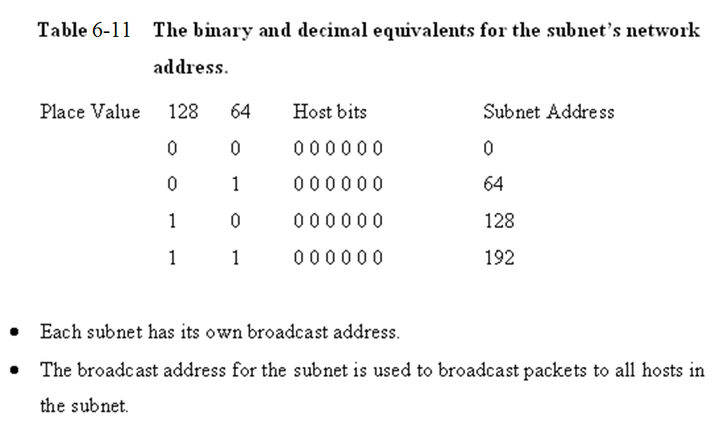

Slide 28
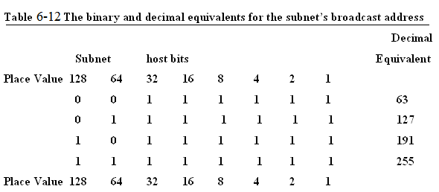

Slide 29
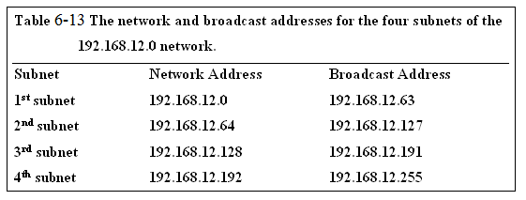

Slide 30
Example 6-8
Given a network address of 10.0.0.0, divide the network into 8 subnets. Specify the subnet mask, the broadcast addresses, and the number of usable hosts/subnet.

Slide 31
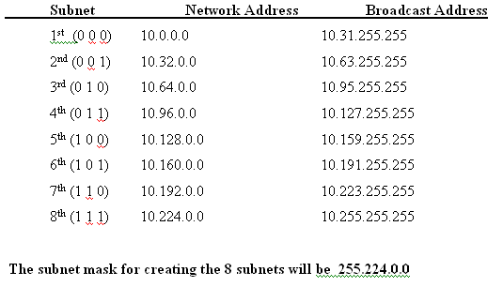


Slide 32
Network + Subnet
bits host bits
8 + 3
5 + 8 + 8

Slide 33
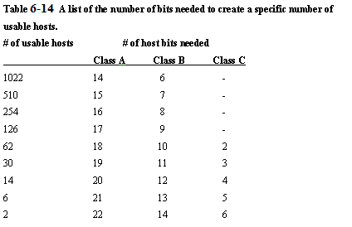

Slide 34
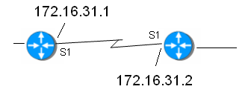
Example 6-9
Determine the subnet mask needed for the router link shown. Only two host addresses are required for this router-to-router link.

Slide 35
Example 6-9
Determine the subnet mask needed for the router link shown. Only two host addresses are required for this router-to-router link.
Answer: 255.255.255.252

Slide 36
Subnet Mask
Computer’s use the subnet mask to control data flow within network’s.
The subnet mask is used to determine if the destination IP address is intended for a host in the same LAN or if the data packet should be sent to the gateway IP address of the LAN.
The gateway IP address is typically the physical network interface on a layer 3 switch or a router.

Slide 37
Subnet Mask
For example, assume that the IP address of the computer in the LAN is 172.16.35.3.
A subnet mask of 255.255.255.0 is being used. This means that that all data packets with an IP address between 172.16.35.0 and 172.16.35.255 stay in the LAN.
A data packet with a destination IP address of 172.16.34.15 is sent to the LAN gateway. The 255.255.255.0 subnet mask indicates that all bits in the first three octets must match each other to stay in this LAN.

Slide 38
Destination Network ?
This can be verified by “ANDing” the subnet mask with the destination address as shown.
172. 16. 35.3
255.255.255.0
172. 16. 35.0 in the same subnet as the LAN
172. 16. 34.15
255.255.255 .0
172. 16. 34. 0 not in the same subnet as the LAN

Slide 39
Summary
This section has demonstrated techniques for establishing subnets and subnet masks in computer networks.
Examples have been presented that guide the reader through the process of borrowing bits to determining the number of available hosts in the subnet.

Slide 40
CIDR Blocks
Up to this point, this chapter has focused on the issues of “classful” networks. Classful means that the IP addresses and subnets are within the same network.
The problem with classful addressing is there is a lot of unused IP address space. For example, a class A IP network has over 16 million possible host addresses.
A class B network has over 65,000 host addresses. The fact is only a limited number of class A and B address space has been allocated for Internet use.

Slide 41
Supernetting
A technique called supernetting was proposed in 1992 to eliminate the class boundaries and to make available the unused IP address space.
Supernetting allows multiple networks to be specified by one subnet mask. In other words, the class boundary could be overcome.

Slide 42
CIDR Notation
Supernetting required a simpler way to indicate the subnet mask. The technique developed is called CIDR – Classless InterDomain Routing. CIDR (pronounced cider) notation specifies the number of bits set to a 1 that make up the subnet mask.
For example, the class C size subnet mask 255.255.255.0 is listed in CIDR notation as /24. This indicates the 24 bits are set to a “1”.
A class B size subnet is written as /16 and a class A subnet is written as /8.

Slide 43
CIDR Notation
The CIDR can also be used to represent subnets that only identify part of the octet bits in an IP address.
For example, a subnet mask of 255.255.192.0 is written in CIDR as /18. The /18 comes from the 18 bits that are set to a 1 as shown.
255 255 192 0
1 1 1 1 1 1 1 1 1 1 1 1 1 1 1 1 1 1 1 0 0 0 0 0 0 0 0 0 0 0 0 0

Slide 44
CIDR Question
How will the network address and the subnet mask of
192.168.12.0 255.255.252.0
appear in CIDR notation?

Slide 45
CIDR Question
128 + 64 +32 + 16 + 8 + 4 = 252
1 1 1 1 1 1 0 0

Slide 46
CIDR Question
128 + 64 +32 + 16 + 8 + 4 = 252
1 1 1 1 1 1 0 0
255 + 255 + 252
8 + 8 + 6
/22

Slide 47
Answer
A network address and the subnet mask of
192.168.12.0 255.255.252.0
can be written in CIDR notation as
192.168.12.0 / 22.

Slide 48
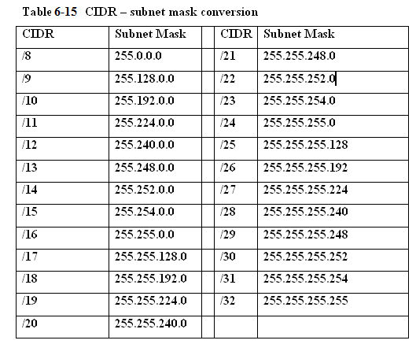
Table 5-15 CIDR – subnet mask conversion

Slide 49
Supernets
CIDR Blocks are used to break down the class barriers in IP addressing. For example, two class C networks
[192.168.78.0/24 and 192.168.79.0/24]
can be grouped together as one big subnet. These two class C networks can be grouped together by modifying the /24 CIDR number to /23.
This means that one bit has been borrowed from the network address bits to combine the two networks into one supernet.

Slide 50
Supernets
Writing these two networks in CIDR notation provides 192.168.78.0 / 23
This reduces the two class C subnets to one larger network. The group of networks defined by CIDR notation is called a CIDR Block.
When you group two or more classful networks together they are called supernets.

Slide 51
Example 6-10
Explore what happens if the boundary in IP
addresses for class C subnets is crossed. For this
example, the subnets have IP addresses of:
192.168.78.0 / 22
192.168.79.0 / 22
192.168.80.0 / 22
192.168.81.0 / 22

Slide 52
Example 6-10 Solution
Apply the /22 subnet mask to
192.168.78.0 and 192.168.80.0
provides the following.
Place Value 128 64 32 16 8 4 2 1
192. 168. 78. 0 IP 0 1 0 0 1 1 1 0
255. 255.252. 0 SM 1 1 1 1 1 1 0 0
192. 168. 76. 0 0 1 0 0 1 1 0 0 (76)
64 + 8 + 4 = 76

Slide 53
Example 6-10 Solution
Now the same subnet mask is applied to the
192.168.80.0 subnet.
Place Value 128 64 32 16 8 4 2 1
192. 168. 80. 0 IP 0 1 0 1 0 0 0 0
255. 255.252. 0 SM 1 1 1 1 1 1 0 0
192. 168. 80. 0 0 1 0 1 0 0 0 0 (80)
64 + 16 = 80

Slide 54
Boundary Lines
Applying the /22 subnet mask places these two IP addresses in different subnets.
The first IP address is placed in the “76” subnet while the second IP address is placed in the “80” subnet”.
The boundary line has been crossed placing the IP addresses in different subnets when the /22 is applied.

Slide 55
Crossing Boundaries
This example shows what will happen if a boundary is crossed in IP addressing.
If four class C subnets need to be grouped into one CIDR block then IP addresses from the ranges shown could be used.
192.168.76.0 to 192.168.79.0
(all will be in the “76” subnet)
192.168.80.0 to 192.168.83.0
(all will be in the “80” subnet)
Careful planning is required to make sure the IP addresses can all be specified by the same subnet mask.

Slide 56
IPv6
IP version 6 (IPv6) is the proposed solution for expanding the possible number of users on the Internet. IPv6 is also called IPng, the next generation IP.
IPv6 uses a 128-bit address technique as compared to IPv4’s 32-bit address structure.
IPv6 provides for a large number of IP addresses (2¹²⁸).

Slide 57
IPv6
IPv6 numbers are written in hexadecimal rather than dotted decimal. For example, the following is a 32 hexadecimal digit IPv6 address. (Note: 32 hex digits x 4 bits/hex digit = 128 bits)
6789:ABCD:1234:EF98:7654:321F:EDCB:AF21
This is classified as a full IPv6 address. The “full” means that all 32 hexadecimal positions contain a value other than 0.

Slide 58
IPv6
IPv6 uses 7 colons (:) as separators to group the 32 hex characters into 8 groups of four.
Some IPv6 numbers will have a 0 within the address. In this case, IPv6 allows the number to be compressed to make it easier to write the number.
For example, assume that an IPv6 number is as follows:
6789:0000:0000:EF98:7654:321F:EDCB:AF21

Slide 59
IPv6 [double-colon]
Consecutive 0’s can be dropped and a double-colon notation can be used as follows:
6789:0000:0000:EF98:7654:321F:EDCB:AF21
6789::EF98:7654:321F:EDCB:AF21

Slide 60
IPv6 [double-colon]
Recovering the compressed number in double-colon notation simply requires that all numbers left of the double notation be entered beginning with the left most slot of the IPv6 address.
Next, start with the numbers on right of the double-colon. Begin with the right most slot of the IPv6 address slots and enter the numbers from right to left until the double-colon is reached. Zeros are entered into any empty slots.
6789::EF98:7654:321F:EDCB:AF21
6789 : 0 : 0 :EF98 :7654 :321F :EDCB :AF21

Slide 61
IPv6
IPv4 numbers can be written in the new IPv6 form by writing the IPv4 number in hexadecimal and placing the number to the right of a double-colon.
Example 6-11 demonstrates how a dotted-decimal IP number can be converted to IPv6 hexadecimal.

Slide 62
Example 6-11
Problem: Convert the IPv4 address of 192.168.5.20 to an IPv6
hexadecimal address.
Solution: First convert each dotted-decimal number to hexadecimal.
Decimal Hex
192 C0
168 A8
5 05
20 14
(Hint: use a calculator or a lookup table to convert the decimal numbers to hexadecimal.)

Slide 63
Example 6-11
The IPv6 address will have many leading 0’s, therefore the IPv6 hex address can be written in double-colon notation as:
:: C0A8:0514

Slide 64
Example 6-11
IPv4 numbers can also be written in IPv6 form by writing the IPv4 number in dotted-decimal format as shown.
Note that the number is preceded by 24 hexadecimal 0’s.
0000: 0000: 0000: 0000: 0000: 0000:192.168.5.20
This number can be reduced as follows:
::192.168.5.20

Slide 65
Types of IPv6 addresses
There are three types of IPv6 addresses. These are unicast, multicast, and anycast.
The unicast IPv6 address is used to identify a single network interface address and data packets are sent directly to the computer with the specified IPv6 address.
There are several types of unicast addresses including link-local addresses, global unicast addresses, and unique local addresses. Link-local addresses are designed to be used for and are limited to communications on the local link.
Every IPv6 interface will have one link-local address.

Slide 66
Types of IPv6 addresses
Multicast IPv6 addresses are defined for a group of networking devices. Data packets sent to a multicast address are sent to the entire group of networking devices such as a group of routers running the same routing protocol.
Multicast addresses all start with the prefix FF00::/8. The next group of characters in the IPv6 multicast address (the second octet) are called the scope. The scope bits are used to identify which ISP should carry the data traffic.

Slide 67
Types of IPv6 addresses
The anycast IPv6 - unicast addresses says “send to this one address” and multicast addresses are used to send the data packets “to every member of this group”,
Anycast addresses says “send to any one member of this group”. In choosing which member to send to, we would for efficiency reasons normally send to the closest one—closest in routing terms.
So we can normally also consider anycast to mean
“send to the closest member of this group”.

Slide 68
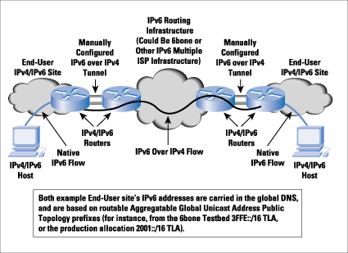
IPv6-over-IPv4 tunneling
Source: Cisco Systems
This is a technique for encapsulating IPv6 packets within the IPv4 format so the packets can be carried over the IPv4 network.

Slide 69
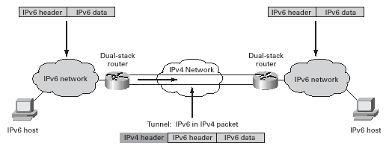
IPv6-over-IPv4 tunneling
Source: Cisco Systems
All tunneling mechanisms require that the endpoints of the tunnel run both IPv4 and IPv6 protocol stacks, that is, endpoints must run in dual-stack mode. The dual-stack routers run both IPv4 and IPv6 protocols simultaneously and thus can interoperate directly with both IPv4 and IPv6 end systems and routers.
For proper operation of the tunnel mechanisms, appropriate entries in a DNS that map between host names and IP addresses for both IPv4 and IPv6 allow the applications to choose the required address.

Slide 70
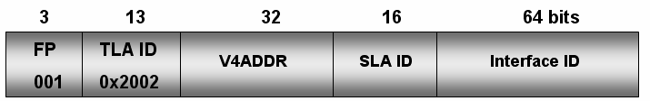
6to4 Prefix (IPv6 over IPv4 Tunneling
The structure of the 6to4 prefix for hosts is provided. The 32 bits of the IPv4 address fit into the first 48 bits of the IPv6 address.

Slide 71
6to4 Prefix (IPv6 over IPv4 Tunneling
FP is the Format Prefix which is made up of the higher order bits. The 001 indicates that this is a global unicast address.
TLA ID (0x2002) is the Top Level Identifiers and is issued to local Internet registries. These IDs are administered by IANA (http://www.iana.org/).
The TLA is used to identify the highest level in the routing hierarchy. The TLA ID is 13 bits long.

Slide 72
6to4 Prefix (IPv6 over IPv4 Tunneling
V4ADDR is the IPv4 address of the 6to4 endpoint and is 32 bits long.
SLA ID is the Site Level Aggregation Identifier that is used by individual organizations to identify subnets within their site. The SLA ID is 16 bits long.

Slide 73
6to4 Prefix (IPv6 over IPv4 Tunneling
Interface ID is the Link Level Host Identifier is used to indicate an interface on a specific subnet. The interface ID is equivalent to the host IP address in IPv4.

Slide 74
SLACC
Stateless address autoconfiguration (SLAAC) is another important feature of IPv6.
This feature allows for a server-less basic network configuration of the IPv6 computers.
With IPv4, a computer generally obtains its network settings from a DHCP server.
With IPv6, a computer can automatically configure its network settings without a DHCP server by sending a solicitation message to its IPv6 router.

Slide 75
IPv6 Transition
When will the Internet switch to IPv6?
The answer is not clear but the networking community recognizes that something must be done to address the limited availability of IP current address space.
Many manufacturers have already incorporated IPv6 capabilities in their routers and operating systems.
What about IPv4? The bottom-line is the switch to IPv6 will not come without providing some way for IPv4 networks to still function.

Slide 76
IPv6 Transition
When will the Internet switch to IPv6?
The answer is not clear but the networking community recognizes that something must be done to address the limited availability of IP current address space.
Many manufacturers have already incorporated IPv6 capabilities in their routers and operating systems.
What about IPv4? The bottom-line is the switch to IPv6 will not come without providing some way for IPv4 networks to still function.

